Slide 1
Academy Assist
A Question answering system for s.p.i.t.
Project mentor - Prof. ANAND Godbole
Nirav Jain
Sanjana Agarwal
- Shantanu Bhandalkar

Slide 2
Introduction
Question Answering (QA) is a field concerned with building systems that automatically answer questions posed by humans in a natural language.
Academy Aider is a closed domain question answering system, focused on resolving queries related to Sardar Patel Institute of Technology.
The user has to speak or type his question, which will then be processed using NLP techniques.

Slide 3
Motivation
Ever since the release of Personal Assistant Software's by Google, Apple and Microsoft, Question Answering has always intrigued us.
There are lot of such potential details about the college, which are publically available but cannot be put to use by technology, majorly because this information is not structured in a proper way.
Thus, we decided to organize such available information, and build a system around it which can be reached out to most of the students in our college.
Since almost everyone carries a smart phone in college, we decided to build a mobile application for the same. This will ease a student’s task of querying about college much easier.

Slide 4
What is our system?
Our system is a question answering system, which will work as an application on the android devices of Sardar Patel Institute of Technology students to help them resolve various types of queries related to the college.
Input question – process – Give back the answer
For example, if the user asks “Where is the library located?” The system would reply “The library is on the second floor.”
For the time being, input question can only be of the following domains: 1) People 2) Classrooms / Labs 3) Utilities.

Slide 5
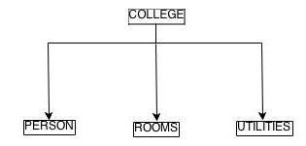
Proposed System
Below, displayed is the image of the database hierarchy we have undertaken. The entity COLLEGE is divided into:
1) Persons
2) Rooms
3) Utilities.
The further division of the table is shown in the image below.

Slide 6
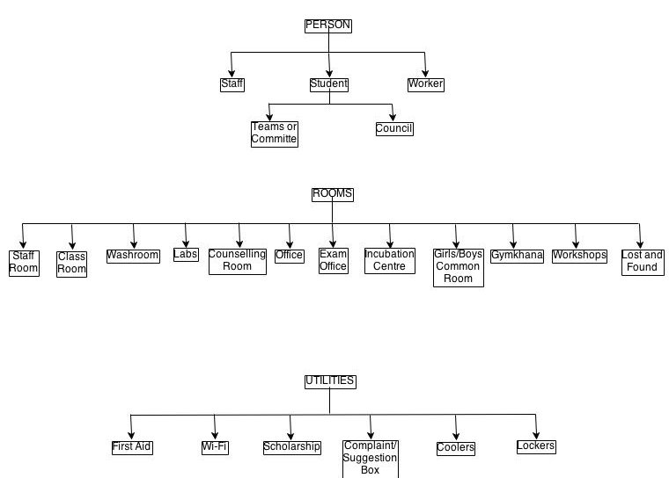

Slide 7
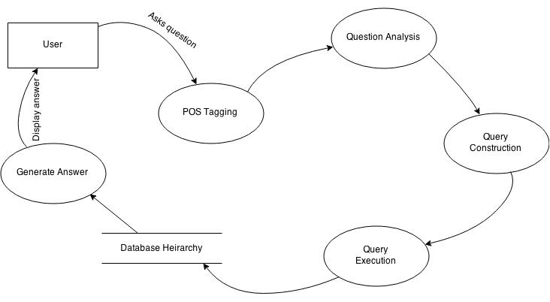
Data Flow Diagram

Slide 8
Question Parsing
Stanford POS Tagging
Identifies the parts of speech in the question such as nouns, verbs and so on.
Named Entity Recognition
Determines the class to which a particular noun belongs.
Keyword Extraction
Extract the keywords that will help query the knowledge base.

Slide 9
Question Classification
A question can be classified into various types such reasoning, factoid, procedural, and so on.
Our system will answer the questions which fall in the category ‘Factoid.’

Slide 10
Knowledge Base
We are using NoSQL to build our knowledge base.
The reason for using NoSQL is that an entity can have various unique attributes specific to itself.
Therefore, querying in such a database is easier instead of using JOINS on various tables in SQL.
Thus, we have objects corresponding to each person, room and utility, storing their details in JSON format.

Slide 11
Answer Generation
Based on the Named Entity and the keywords, one or more documents are retrieved.
The value of the expected answer type is the answer to be presented to the user.

Slide 12
Conclusion
The software is a closed domain question answering system, which works as a query resolver.
We are using NLP techniques such a Named Entity Recognition, Part of Speech Tagging and Answer Extraction (IE)
The knowledge base is designed in such a way that more than three domains can be added in the future.
This would serve as a Portable Information Kiosk for S.P.I.T. students.

